Slide 1
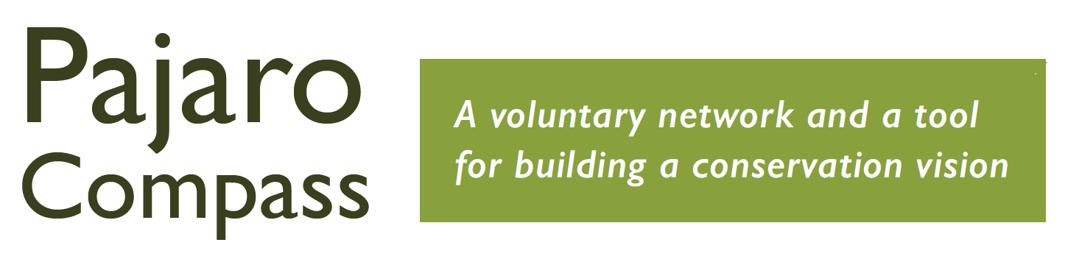
How to get ready for conservation - highlights from our 2018 publication
Abigail Ramsden
Karminder Brown
The Nature Conservancy
aramsden@tnc.org
(415) 281-0435
San Benito Working Landscapes Group
karminder.brown@gmail.com
(831) 524-3816

Slide 2
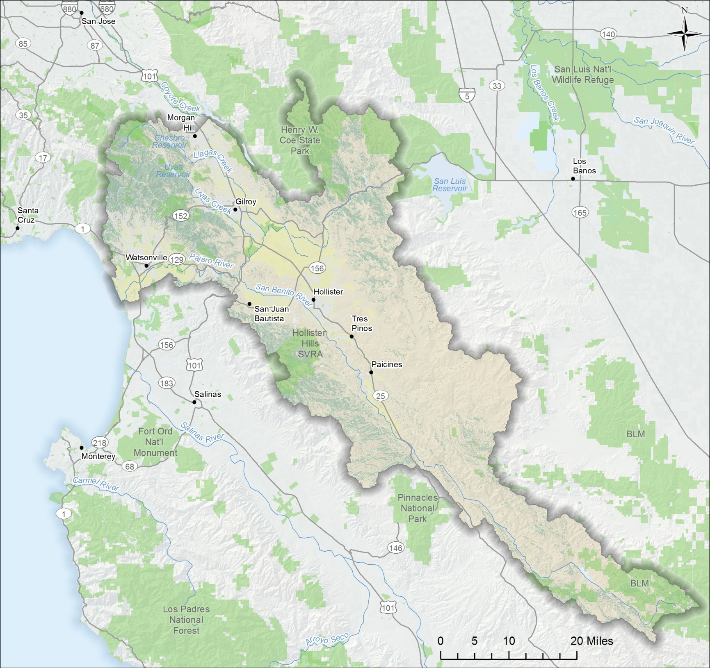
Pajaro River Watershed

Slide 3
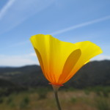
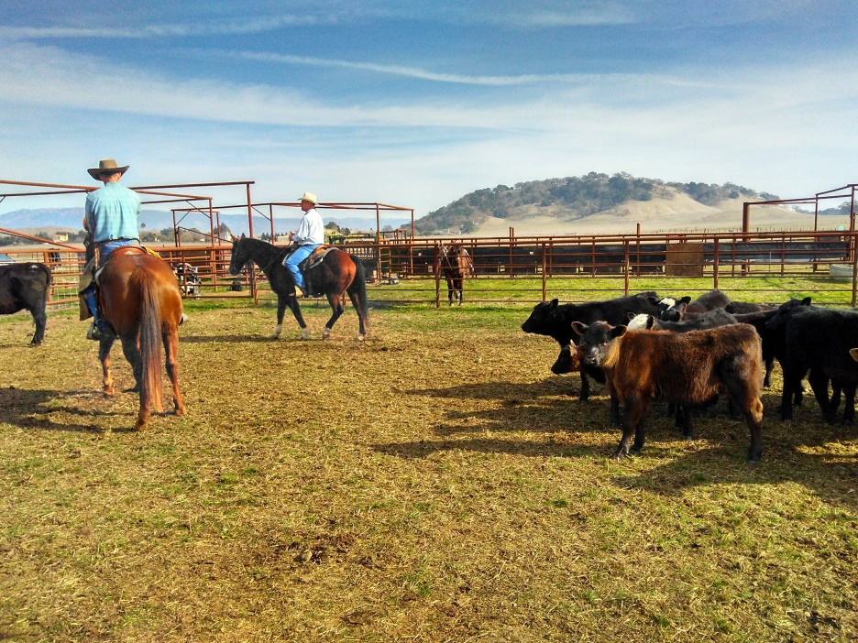
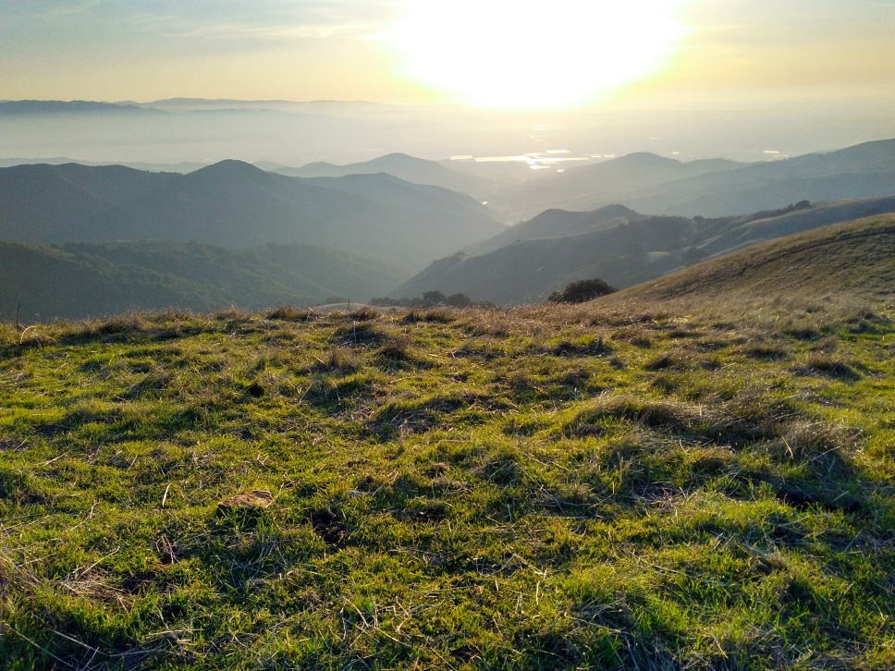
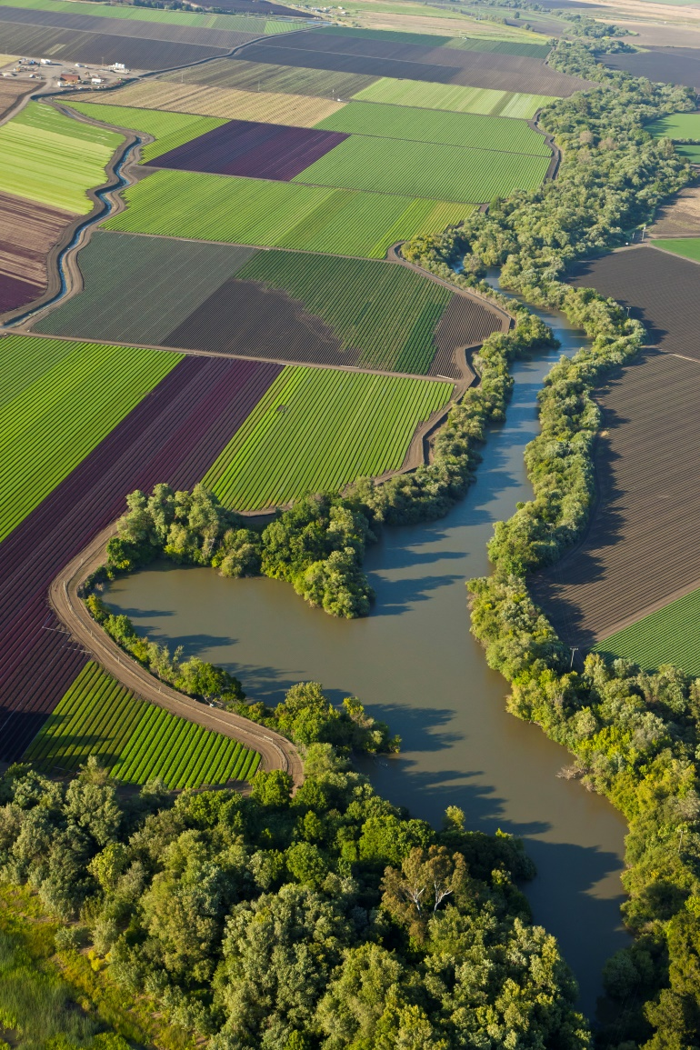
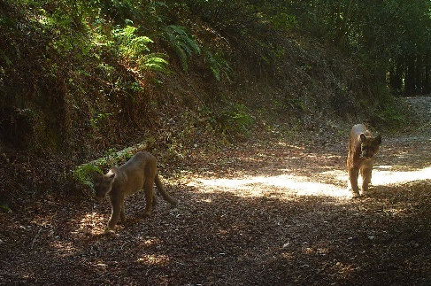
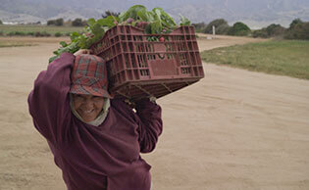
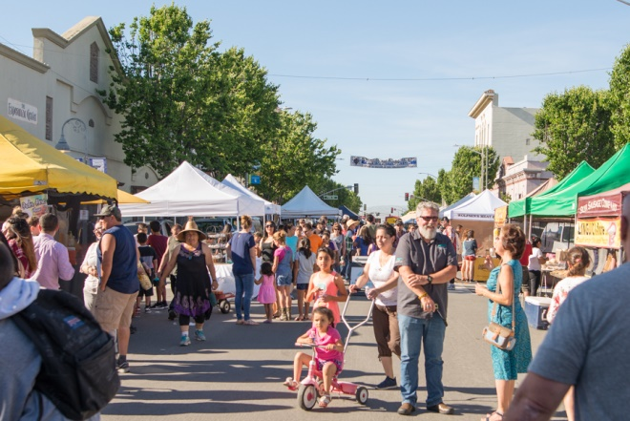
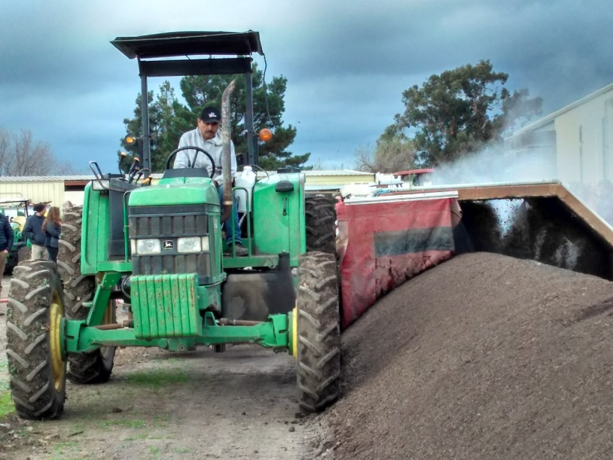

Slide 4
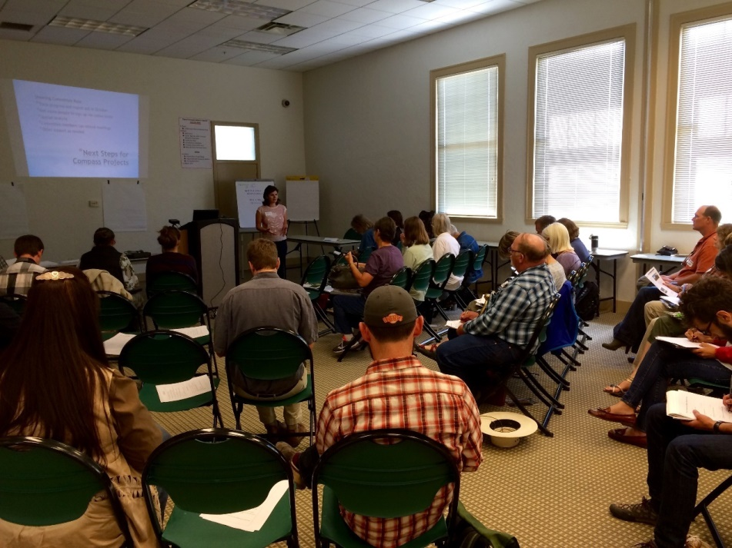
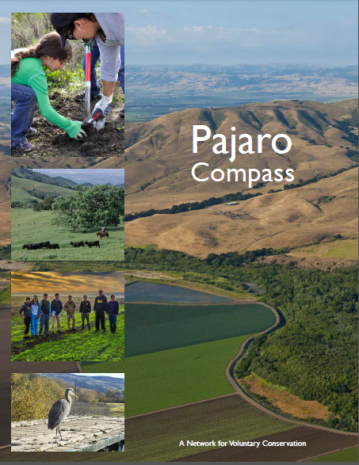
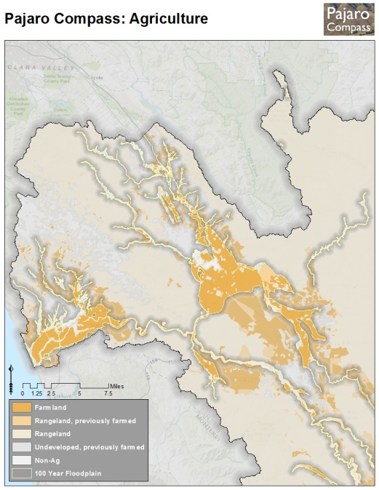
What is the Pajaro Compass?
Document and associated on-line map tools
Stakeholder Forum convened twice annually
Network with over 50 members - individuals/agencies/NGOs
Steering committee meets monthly

Slide 5
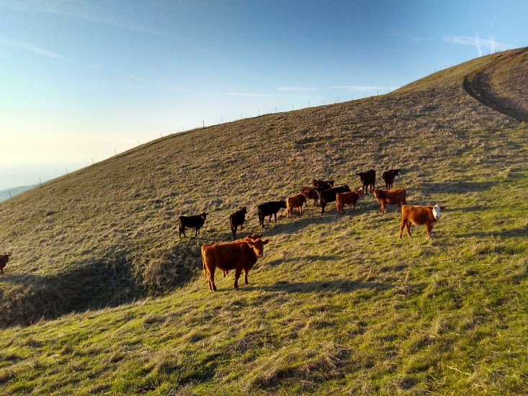
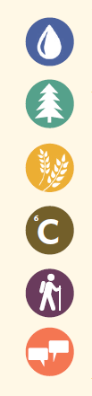
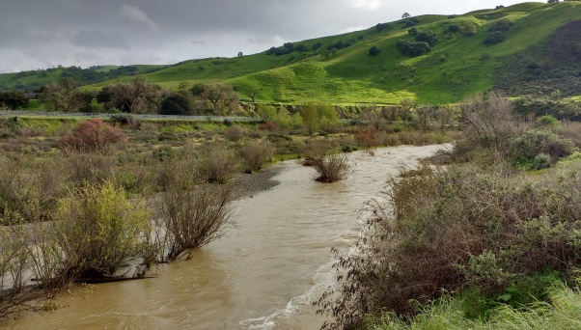
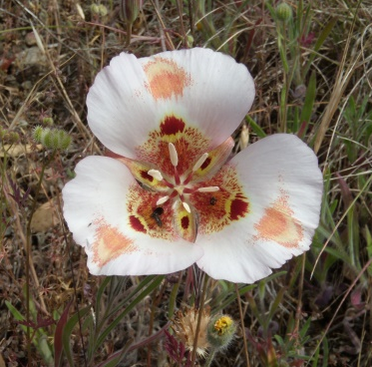
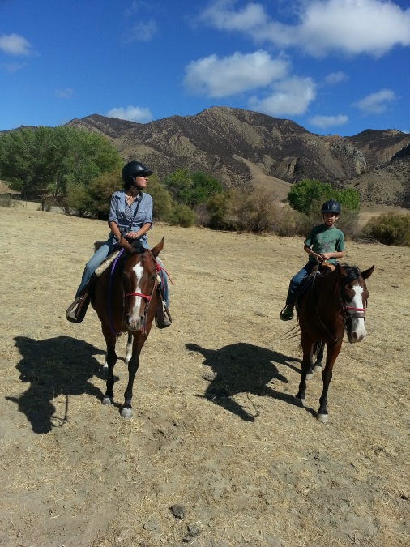
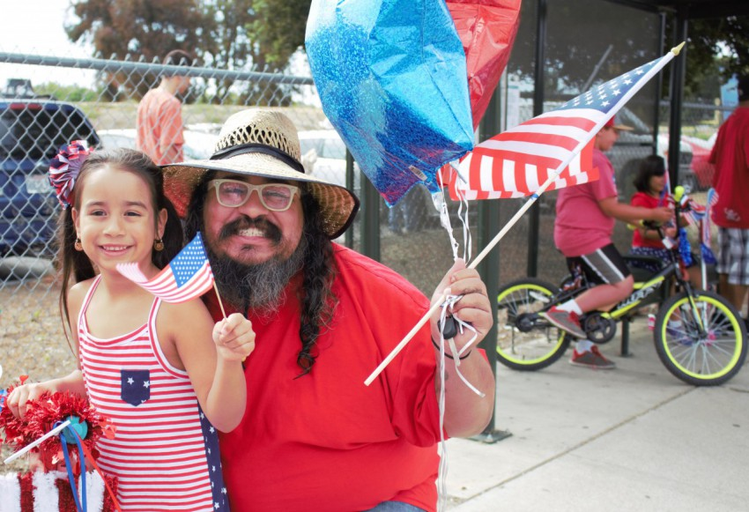
Pajaro Compass Themes
Water Resources
Biodiversity
Agriculture
Carbon and Soil Health
Recreation
Community

Slide 6
Making it clear what it is and what it isn’t
Ongoing, flexible forum
The map is not the territory
Bringing people together in and outside of meetings
Building trust through transparent decision-making
Working landscapes, working people
What it took – leadership, vision and funding

Slide 7
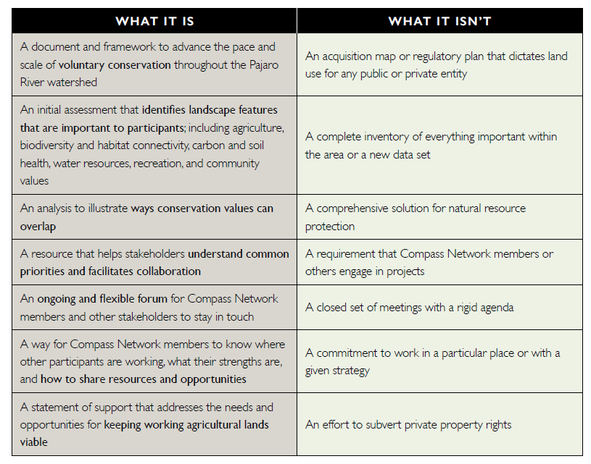
Making it clear what it is and what it isn’t

Slide 8
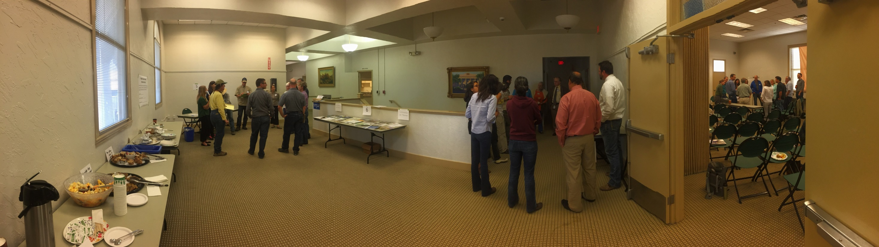
Ongoing, flexible forum

Slide 9
The map is not the territory

Slide 10
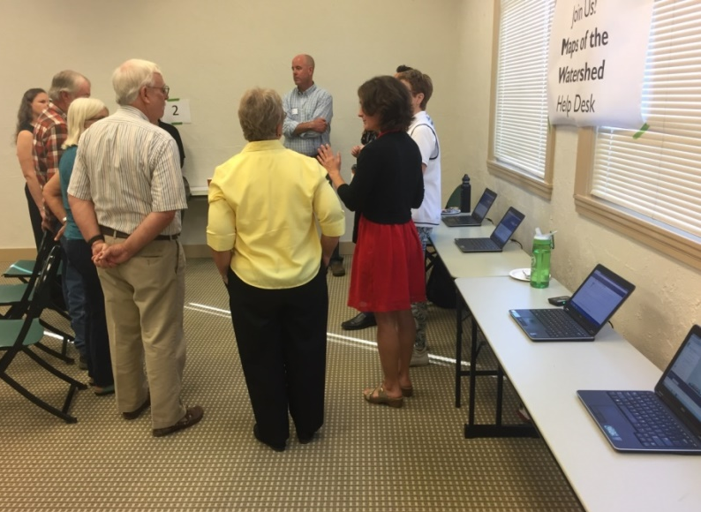
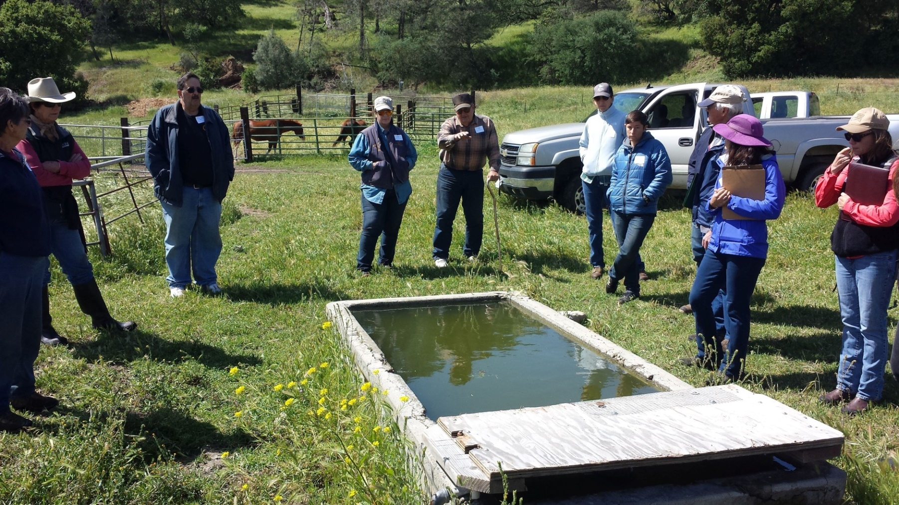
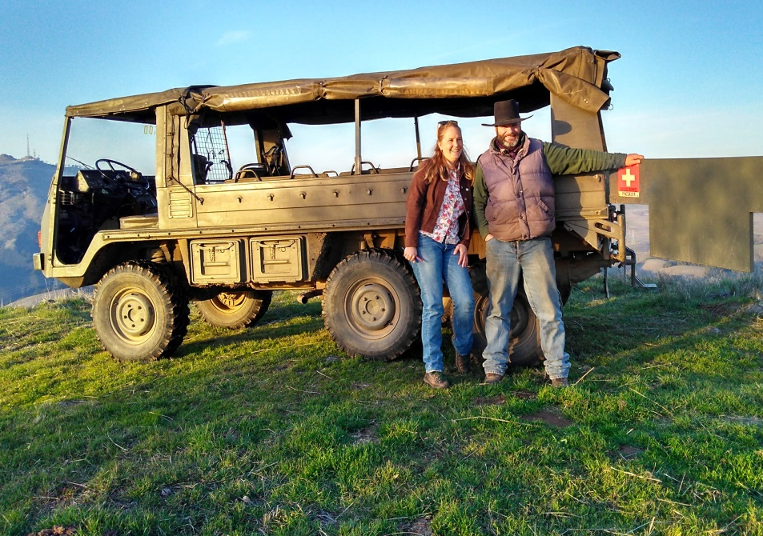
Bringing people together in and outside of meetings

Slide 11
Building trust through transparent decision-making

Slide 12
Working landscapes, working people

Slide 13
What it took – leadership, vision, and funding

Slide 14
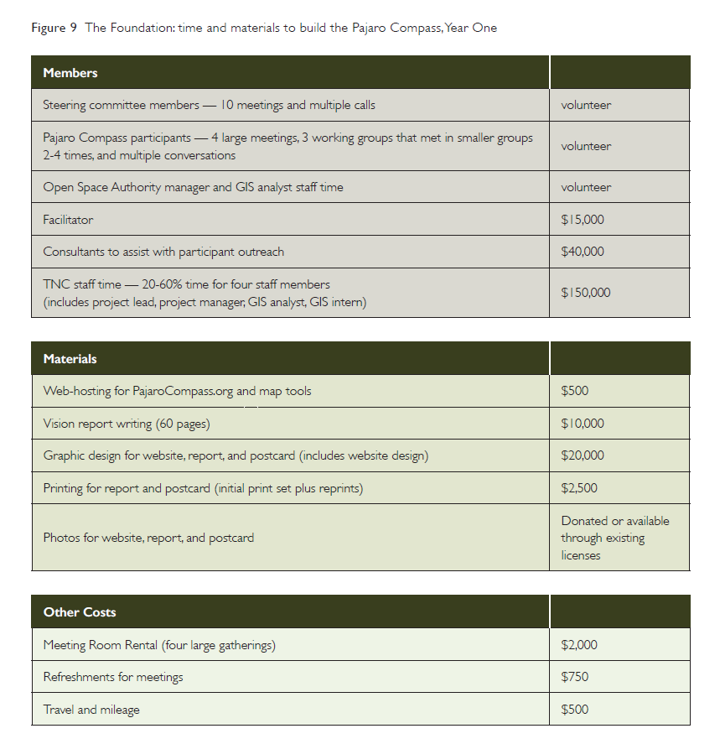
What it took – leadership, vision, and funding

Slide 15
Next Network meeting: April 25, 2018 at Gabilan Ranch
Abigail Ramsden
Karminder Brown
The Nature Conservancy
aramsden@tnc.org
(415) 281-0435
San Benito Working Landscapes Group
karminder.brown@gmail.com
(831) 524-3816

